Slide 1
Enhancement Process Alert System (EAS)

Slide 2
Introduction
This document describes high level architecture of Enhanced process alert system. The requirement is to capture each task from the given Document’s and notify the actors with respective alerts.

Slide 3
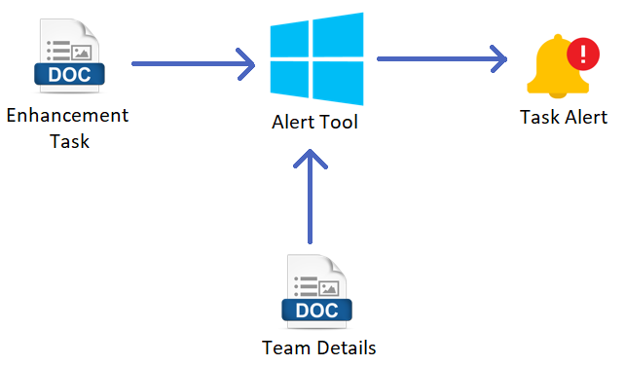
Enhancement Task – This file consists of all the responsibility to respected position with respected date for 6 weeks.
Team Details – Consist of team details who the tasks will be assigned.
Alert Tool – It is the Tool which needs to check jobs assigned for respective employees and send alert notification regarding job on time.

Slide 4
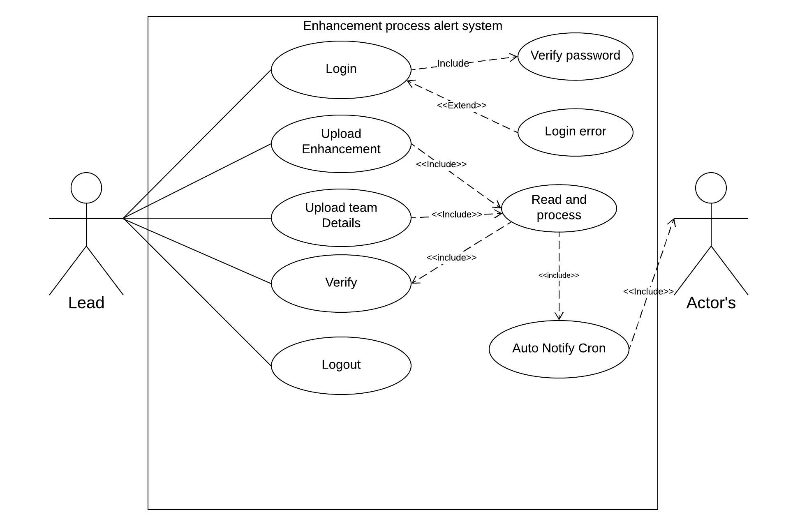
Use Case:

Slide 5
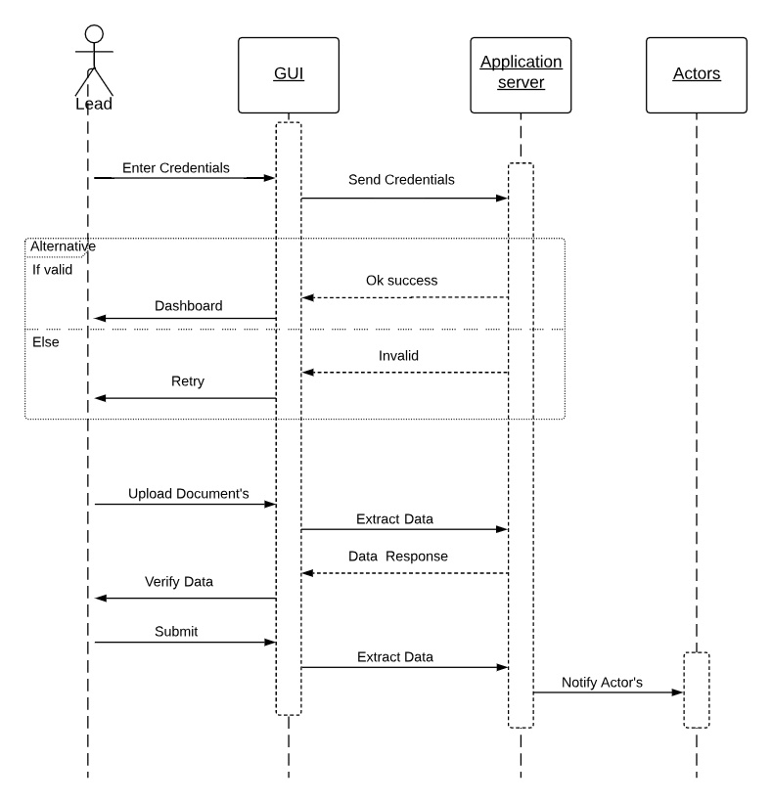
Sequence Diagram:

Slide 6
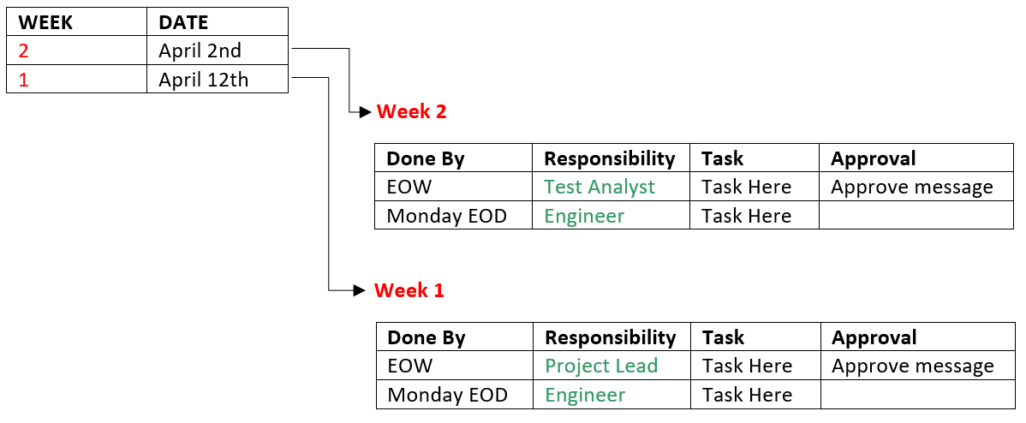
Enhancement Document Format:

Slide 7
Assignee Document Format:

Slide 8





Internal Work Process:
Enhancement.docx
Enhancement.cs
FindMatch.cs
Assignee.docx
Assignee.cs
.
.
.
Verify.cs
OutlookEvent.cs

Slide 9
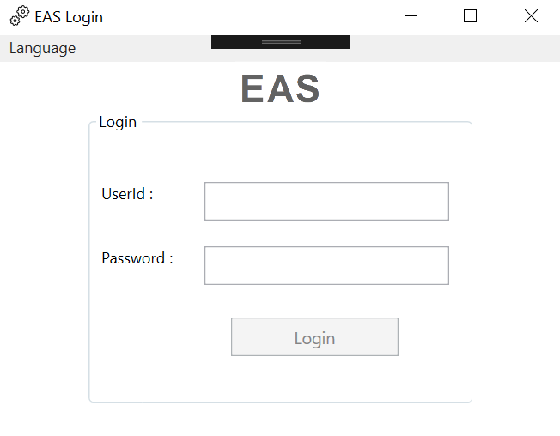
Login:

Slide 10
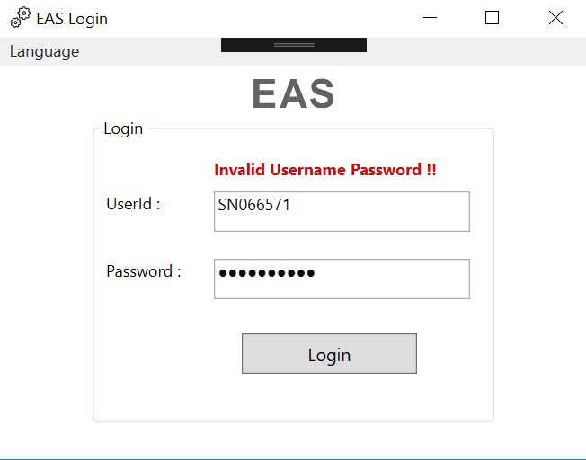
Invalid Password:

Slide 11
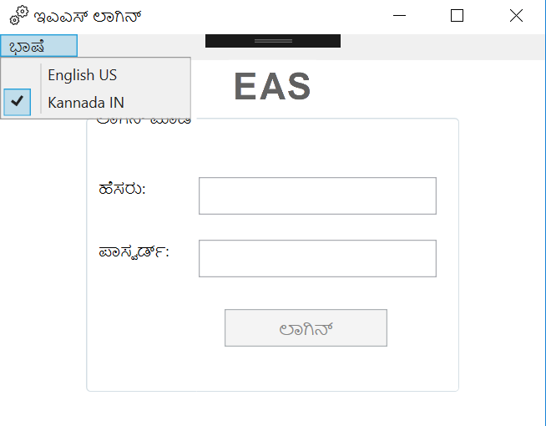
Localization:

Slide 12
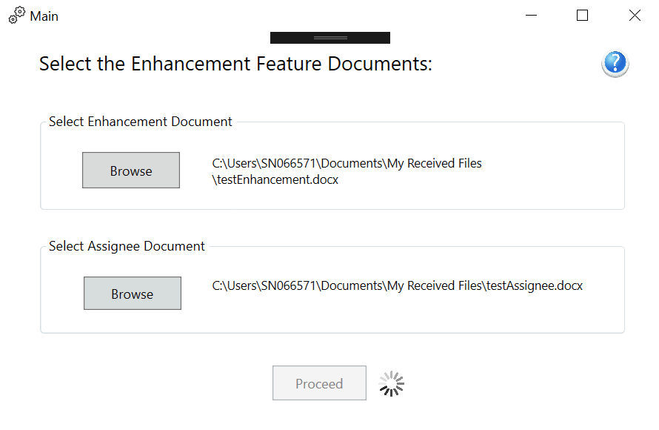
Document Browse:

Slide 13
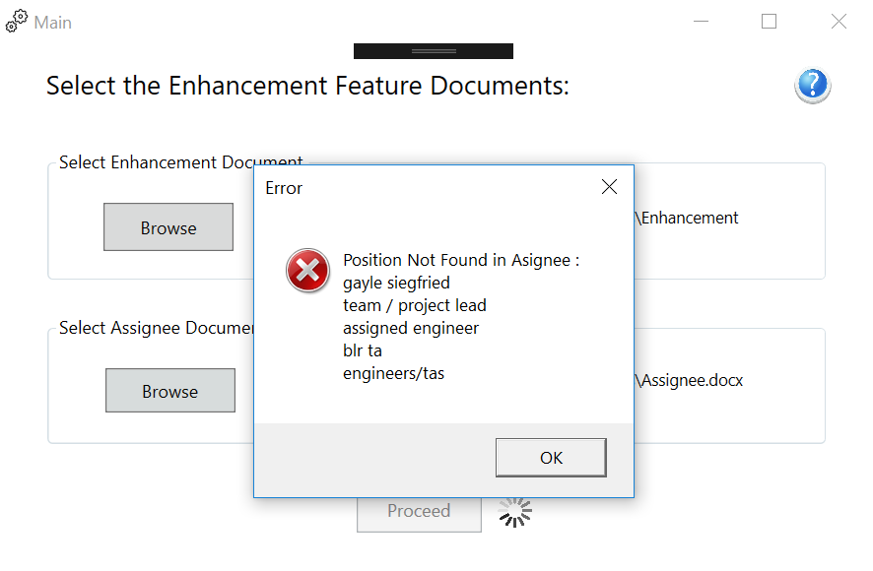
Position Not Found:

Slide 14
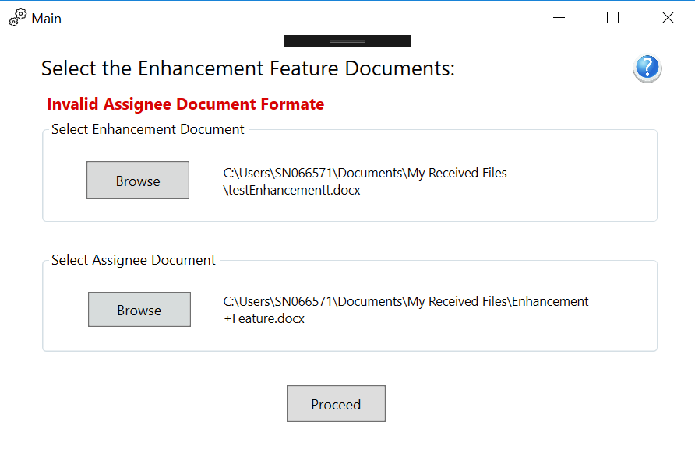
Invalid Document Format:

Slide 15
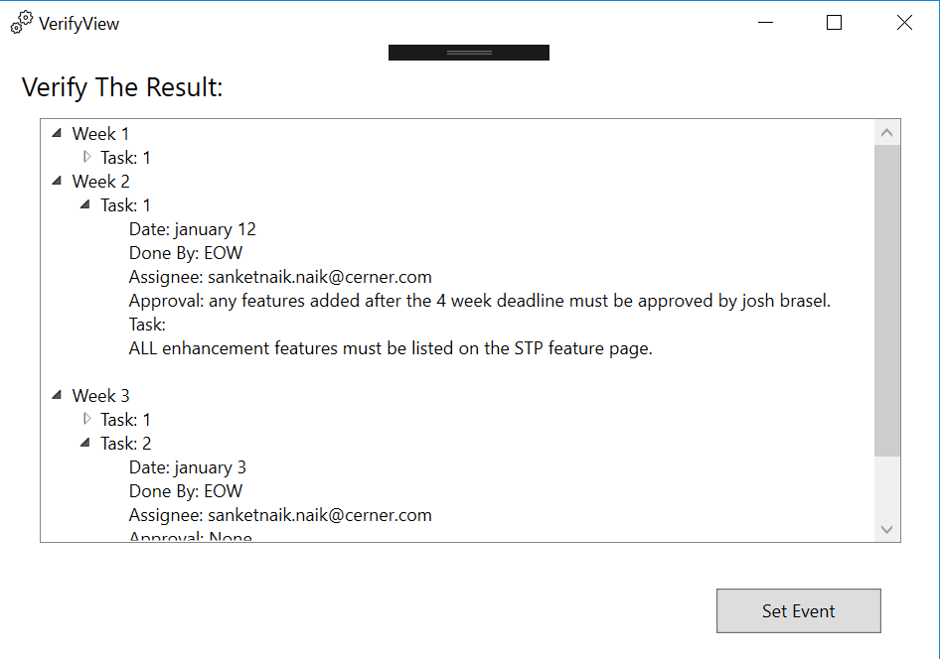
Verify Data:

Slide 16
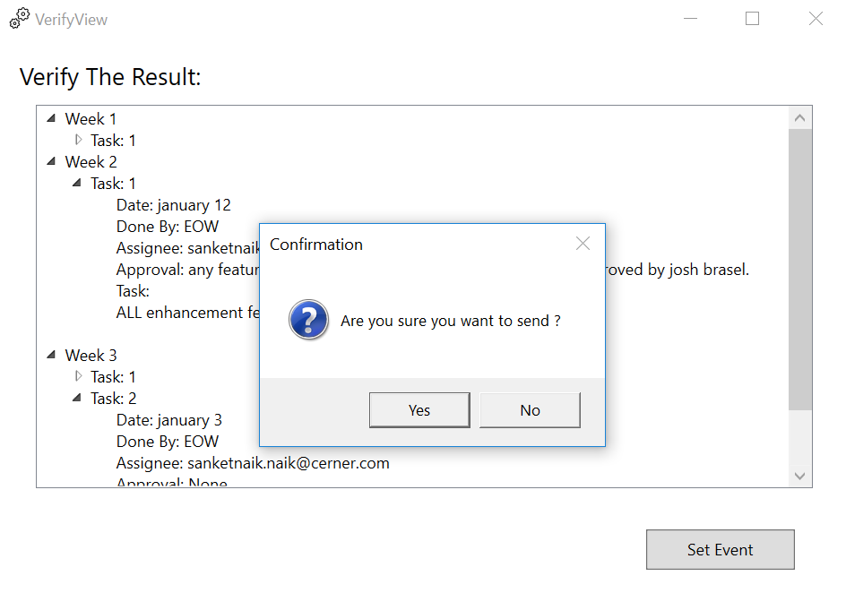
Event Schedule:

Slide 17
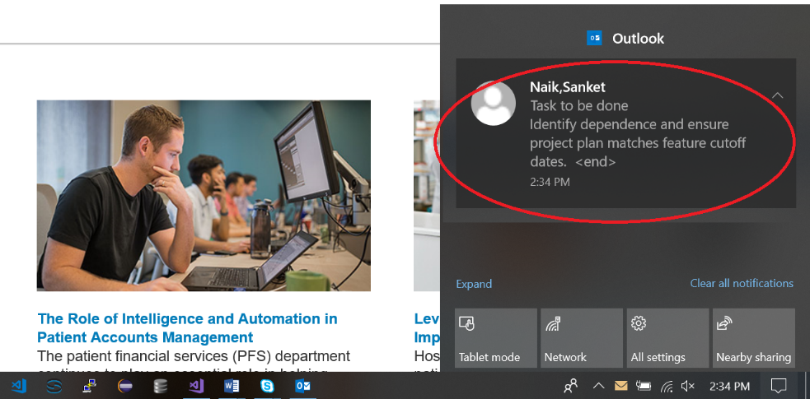
Notification:

Slide 18
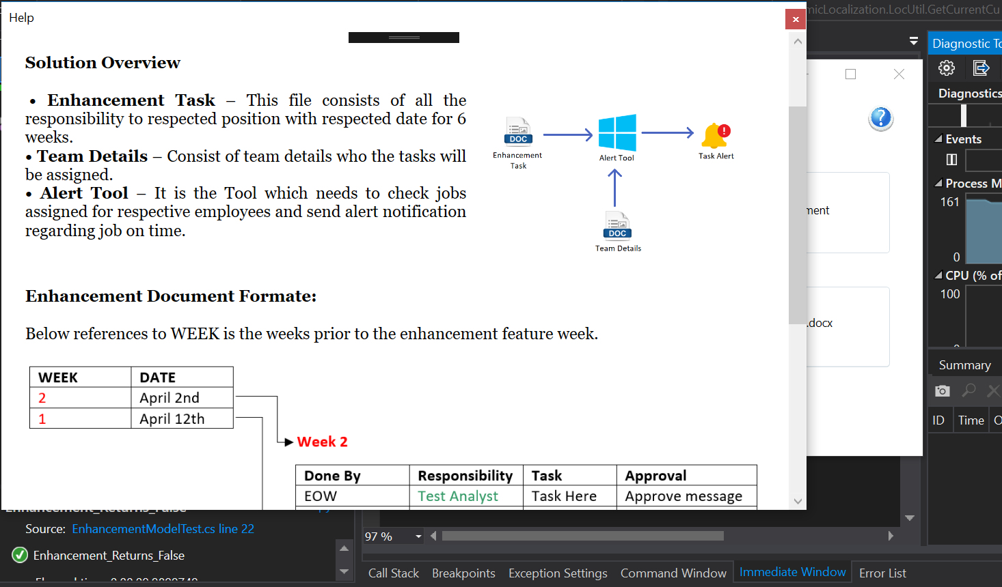
Help Window:

